Slide 1



Operating System
Unit – 4
Memory Management
Subject Faculty: Prof. Aanchal Phutela
Computer Engineering
aanchal.phutela@gu.edu.in

Slide 2
Disclaimer
It is hereby declared that the production of the said content is meant for non-commercial, scholastic and research purposes only.
We admit that some of the content or the images provided in this channel's videos may be obtained through the routine Google image searches and few of them may be under copyright protection. Such usage is completely inadvertent.
It is quite possible that we overlooked to give full scholarly credit to the Copyright Owners. We believe that the non-commercial, only-for-educational use of the material may allow the video in question fall under fair use of such content. However we honor the copyright holder's rights and the video shall be deleted from our channel in case of any such claim received by us or reported to us.

Slide 3
Topics to be covered
Basics of Memory Management
Memory partitioning: Fixed and Variable Size Partitioning
Memory Allocation Strategies (First Fit, Best Fit, and Worst Fit)
Swapping and Fragmentation
Paging and Demand Paging
Segmentation
Concepts of Virtual Memory
Page Replacement Policies (FIFO, LRU, Optimal, Other Strategies)
Thrashing

Slide 4
Basics of Memory
There are three important criteria as far as memory is concerned:
Size – larger size of m/m is desirable
Access time – small access time is desirable.
Per unit cost – less per unit cost is desirable.
Can you have a m/m which is large in size, have very less access time and also have less per unit cost??
The answer is No.
As all these three criteria’s would not met simultaneously that’s why we don’t have a single memory in the systems.
+
CPU
Memory

Slide 5
Hierarchy of Memory
CPU
Cache Memory
Main Memory
Secondary Memory

Slide 6
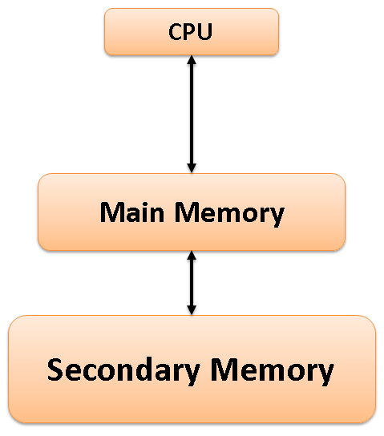
Hierarchy of Memory
Now, here the OS have two important responsibilities:
Space Allocation: Now OS will decide which process from the SM will get which area in MM.
Address Translation i.e. from logical address to physical address.

Slide 7
Memory allocation Techniques
Contiguous memory allocation
Fixed partition
Variable partition
Non-Contiguous memory allocation
Paging
Segmentation

Slide 8
Memory Allocation Techniques
Contiguous Memory allocation
Simple and old method.
Here each process occupies contiguous block of main memory.
When process is brought in memory, a memory is searched to find out a chunk of free memory having enough size to hold a process.

Slide 9
Contiguous M/m allocation: Fixed Partition
Multi programming with fixed partition
Numbers of partitions are fixed.
Here, memory is divided into fixed size partition.
Each partition may contain exactly one process.
Size of each partition is not requires to be same.
When a partition is free, process is selected from the input queue and it is loaded into free partition.

Slide 10
Contiguous M/m allocation: Fixed Partition
Multi programming with fixed partition:
Advantage:
Implementation is simple.
Processing overhead is low.
Disadvantage:
Limit in process size.
Causes External fragmentation because of contiguous memory allocation.
Causes Internal fragmentation due to fixed partition of memory.
Degree of multiprogramming is also limited.

Slide 11
Contiguous M/m allocation: Variable Size Partition
Multi programming with variable/dynamic partition
Here memory is not divided into fixed partition, also the number of partition is not fixed.
Only required memory is allocated to process at runtime.
Whenever any process enter in a system, a chunk of memory big enough to fit the process is found and allocated. And the remaining unoccupied space is treated as another free partition.
When process get terminated it releases the space occupied and it that free partition is contiguous to another free partition then that both free partition can be merge.

Slide 12
Contiguous M/m allocation: Variable Size Partition
Multi programming with variable/dynamic partition:
Advantage:
No internal fragmentation.
No limitation on number of processes.
Disadvantage:
Memory is allocated when process enters into system, and deallocated when terminates. This operation may leads to small holes in the memory.
This holes will be so small that no process can be loaded in it..
But total size of all holes may be big enough to hold any process.
Causes External fragmentation:
No limitation on process size.

Slide 13
Memory Allocation Strategies
In Partition Allocation, when there is more than one partition freely available to accommodate a process’s request, a partition must be selected.
To choose a particular partition, a partition allocation method is needed. A partition allocation method is considered better if it avoids internal fragmentation.
There are different Memory allocation Algorithm are:
First Fit
Best Fit
Worst Fit

Slide 14
Memory Allocation Strategies
First Fit:
In the first fit, the partition is allocated which is the first sufficient block from the top of Main Memory.
It scans memory from the beginning and chooses the first available block that is large enough. Thus it allocates the first partition that is large enough.
Best Fit:
Allocate the process to the partition which is the first smallest sufficient partition among the free available partition.
It searches the entire list of partition to find the smallest partition whose size is greater than or equal to the size of the process.

Slide 15
Memory Allocation Strategies
Worst Fit:
Allocate the process to the partition which is the largest sufficient among the freely available partitions available in the main memory.
It is opposite to the best-fit algorithm.
It searches the entire list of partitions to find the largest partition and allocate it to process.

Slide 16
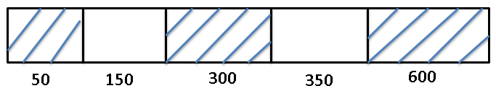
Variable Size Partitioning
P1=300
P2=25
P3=125
P4=50
50
150
300
350
600
First Fit
Best Fit
Worst Fit

Slide 17
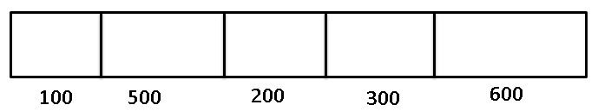
Fixed Size Partitioning
P1=212K
P2=417K
P3=112K
P4=426K
100
500
200
300
600
First Fit
Best Fit
Worst Fit

Slide 18
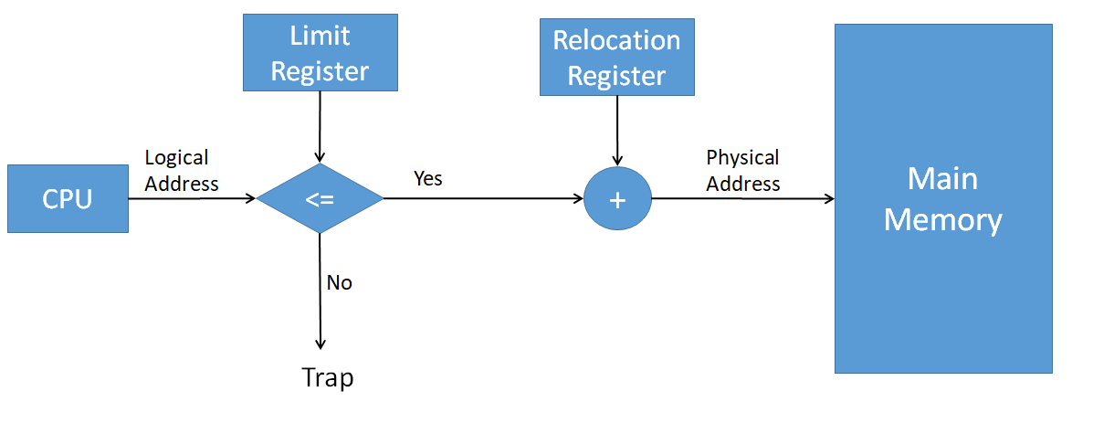
Logical to Physical Address Mapping
Relocation Register : Special purpose register in CPU which holds the base address of the process in main m/m.
Limit register: The size of a process is stored in this register.

Slide 19
Logical to Physical Address Mapping
100
500
52
52
552
For e.g. Values:
Limit Register=100
Relocation Register = 500

Slide 20
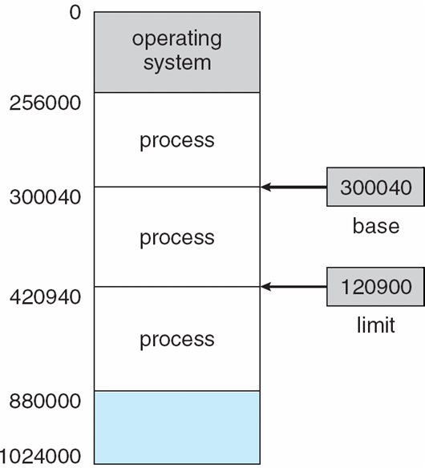
Logical to Physical Address Mapping

Slide 21
Logical to Physical Address Mapping
Question: Check for the following processes are requesting for authenticated instructions or not?
Process | Limit Register | Relocation Register
P1 | 500 | 1200
P2 | 275 | 550
P3 | 212 | 880
P4 | 420 | 1400
P5 | 118 | 200

Slide 22
Non-Contiguous M/m Allocation
Non-Contiguous memory allocation techniques are basically of two types:
Paging
Segmentation
The main disadvantage of Dynamic Partitioning is External fragmentation.
Although, this can be removed by Compaction but as we have discussed earlier, the compaction makes the system inefficient.
That’s why we come up with an idea of non-contiguous memory allocation.

Slide 23
Paging – Basic Idea and its Need
Physical memory (Main Memory)is divided into fixed sized block called frames.
Logical address space (Secondary Memory) is divided into blocks of fixed size called pages.
Page and frame will be of same size.
Whenever a process needs to get execute on CPU, its pages are moved from hard disk to available frame in main memory.

Slide 24
Paging
Thus here memory management task is:
to find free frame in main memory,
allocate appropriate frame to the page,
keeping track of which page belong to which frame.
OS maintains a table called page table, for each process.
Page table is index by page number and stores the information about frame number.

Slide 25

Page number
Frame number

Slide 27
Non-Contiguous M/m Allocation
Page allocation in Paging system
Here one free frame list is maintain.
When a process arrives in the system to be executed, size of process is expressed in terms of number of pages.
Each page of the process needs one frame.
Thus if process requires n pages then n frames must be free in memory.

Slide 28

Before allocation
After allocation

Slide 29
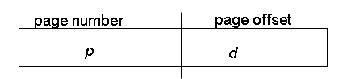
Address Mapping in Paging
Here logical address (L) is divided into two parts:
1. Page number (p)
2. Offset (d): which gives us actual position in the page.
Let page size is 2^n.
So we can get page number (p)= L /2^n
Offset = L% 2^n
Physical address (P)= frame number * page size +d
For given logical address space 2m and page size 2n

Slide 30
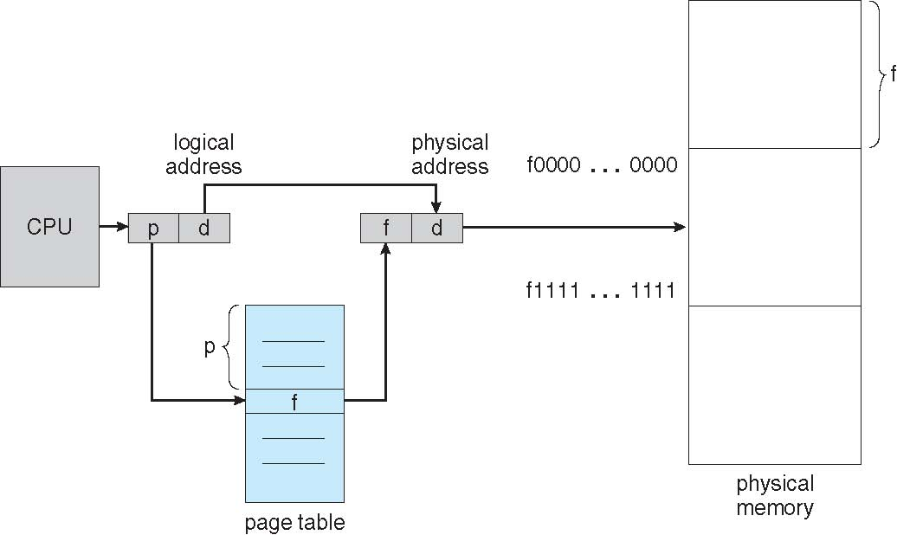
Address Mapping in Paging

Slide 31
Paging: Hardware support
Modern OS uses variations of Paging which are:
Translation look aside buffer
Hierarchical paging
Inverted page table

Slide 32
Translation look aside buffer
Used to overcome the slower access problem.
TLB is page table cache, which is implemented in fast associative memory.
Its cost is high so capacity is limited, thus only subset of page table is kept in memory.
Each TLB contains a page number and a frame number where the page is stored in the memory.

Slide 33
TLB - Working
Whenever a logical address is generated, the page number of logical address is searched in the TLB.
If the page number is found then it is know as TLB hit. In this case corresponding frame number is fetched from TLB entry and used to get physical address. The whole task may take bit longer than it would if an unmapped memory reference were used.
If a match is not found then it is termed as TLB miss, in this case a memory reference to that page must be made. page table is used to get the frame number. And this entry id moved to TLB.
If TLB is full while moving the entry then some of the existing entry in the TLB ae removed. (strategy can be Least Recently Used(LRU) to random).

Slide 34

TLB - Working

Slide 35
TLB
Effective Access Time calculation:
Q- 80 percent hit ratio in TLB, if it takes 20 nanosecond to search in TLB, 100 nanosecond to access main memory, then what is the effective access time to find a page?
A- Hit ratio is 80 percent and miss ratio is 20 percent
Effective access time = H(TLB+MM )+ M(TLB+PT+MM)
= H(TLB+MM )+ M(TLB+2MM)
= 0.8(20+100) + 0.2(20+100+100)

Slide 36
Disadvantages of Paging
Additional memory reference
Its required to read information from page table.
Every instruction requires two memory accesses: one for page table, and one for instruction or data.
Size of page table
Page tables are too large to keep it in main memory.
Page table contain all pages in logical address space thus larger process page table will be large.
Internal fragmentation
A process size may not be exactly of the page size.
So some space would remain unoccupied in the last page of a process. This result in internal fragmentation.

Slide 37
Segmentation
Works on the user point of view, logical address space of any process is a collection of code, data and stack.
Here the logical address space of a process is divided into blocks of varying size, called segments.
Each segment contains a logical unit of process.
When ever a process is to be executed, its segments are moved from secondary storage to the main memory.
Each segment is allocated a chunk of free memory of the size equal to that segment.
OS maintains one table known as segment table, for each process. It includes size of segment and location in memory where the segment has been loaded.

Slide 38
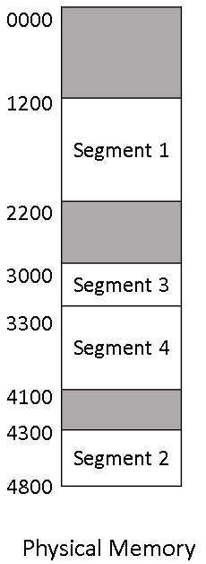
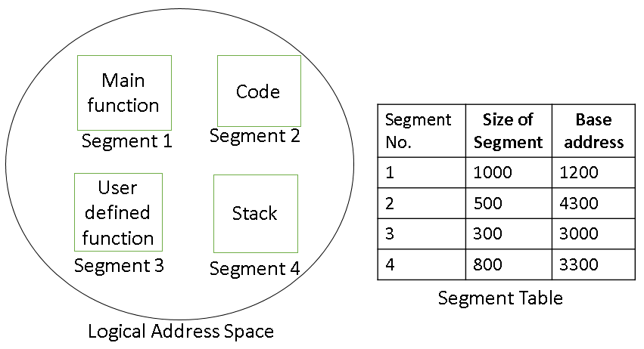
Segmentation
Logical address is divided in to two parts:
Segment number: identifier for segment.
Offset: actual location within a segment.

Slide 39
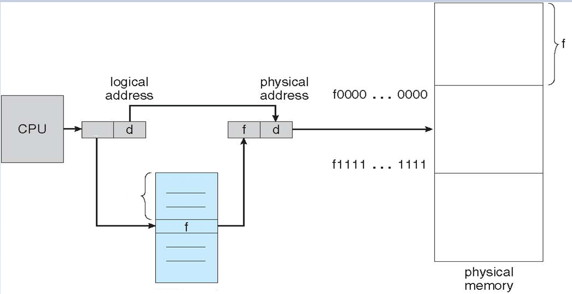
Address Mapping in Segmentation
s

Slide 40
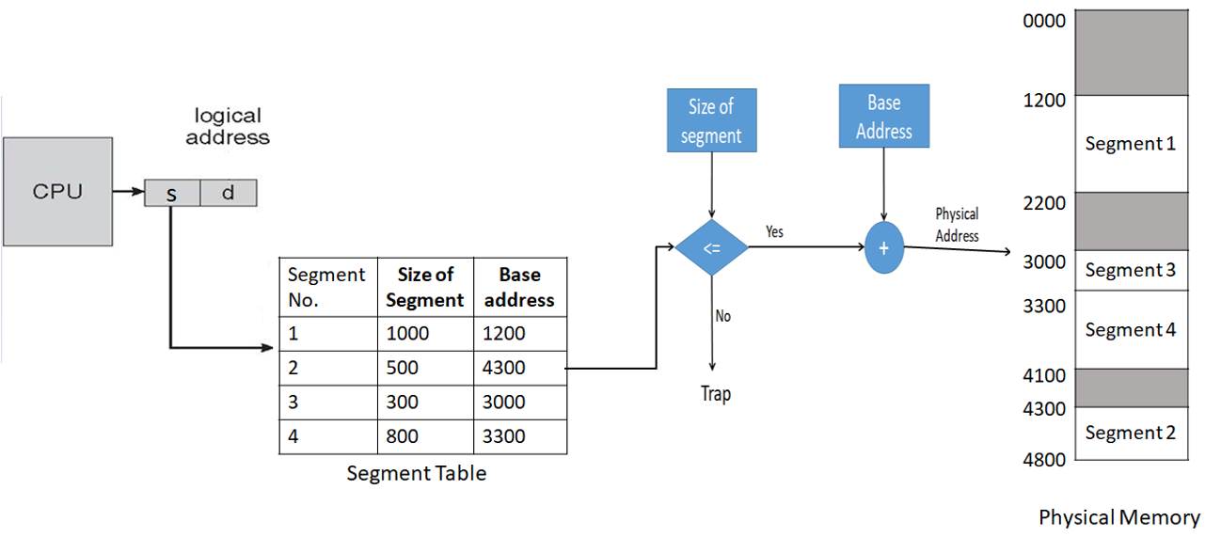
Address Mapping in Segmentation

Slide 41
Virtual Memory
A virtual memory is technique that allows a process to execute even though it is partially loaded in main memory.
The basic idea behind virtual memory is that the combined size of the program, data, and stack may exceed the amount of physical memory( main memory) available for it.
The operating system keeps those parts of the program currently in use in main memory, and the rest on the disk.
These program-generated addresses are called virtual addresses and form the virtual address space.
MMU (Memory Management Unit) maps the virtual addresses onto the physical memory addresses

Slide 42
Advantage of Virtual Memory
Less number of I/O would be needed to load or swap each user program into memory.
A program would no longer be constrained by the amount of physical memory that is available. User would be able to write programs for an extremely large virtual address space.
Each user program could take less physical memory, more programs could be run the same time, with a corresponding increase in CPU utilization and throughput.

Slide 43
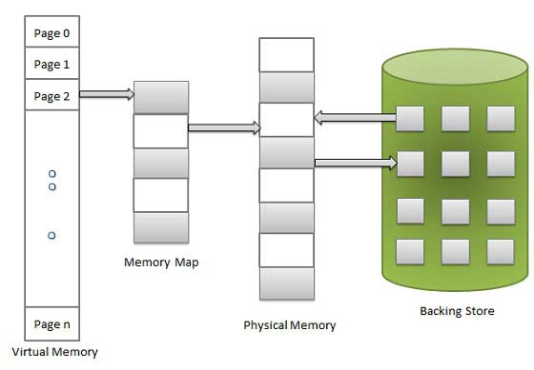

Slide 44
Virtual Memory: Hardware and control structures
Virtual memory involves the separation of logical memory perceived(aware) by user from physical memory.
This separation allows extremely large virtual memory to be provided for programmers when only smaller amount of physical memory is available.
Thus programmer need not to worry about the amount of memory available.

Slide 45
Swapping
Example : A system has a physical memory of size 32-MB. Now suppose there are 5 process each having size 8MB that all want to execute simultaneously. How it is possible???
The solution is to use swapping. Swapping is technique in which process are moved between main memory and secondary memory or disk.
Swapping use some portion of secondary memory as backing store known as swapping area.
Operation of moving process from memory to swap area is called “swap out". And moving from swap area to memory is known as “swap in”.

Slide 46

Swapping

Slide 47
Thrashing
CPU utilization is directly linked to degree of multi programming.
As RAM is limited, so we are using paging concept here.
For e.g. I have 100 processes and each process is divided into some number of pages.
Degree of multiprogramming is maximum, if I will place one page of each process into RAM.
Degree of multiprogramming is achieved here as every process have its one page available in the RAM, but it causes maximum page faults.

Slide 48
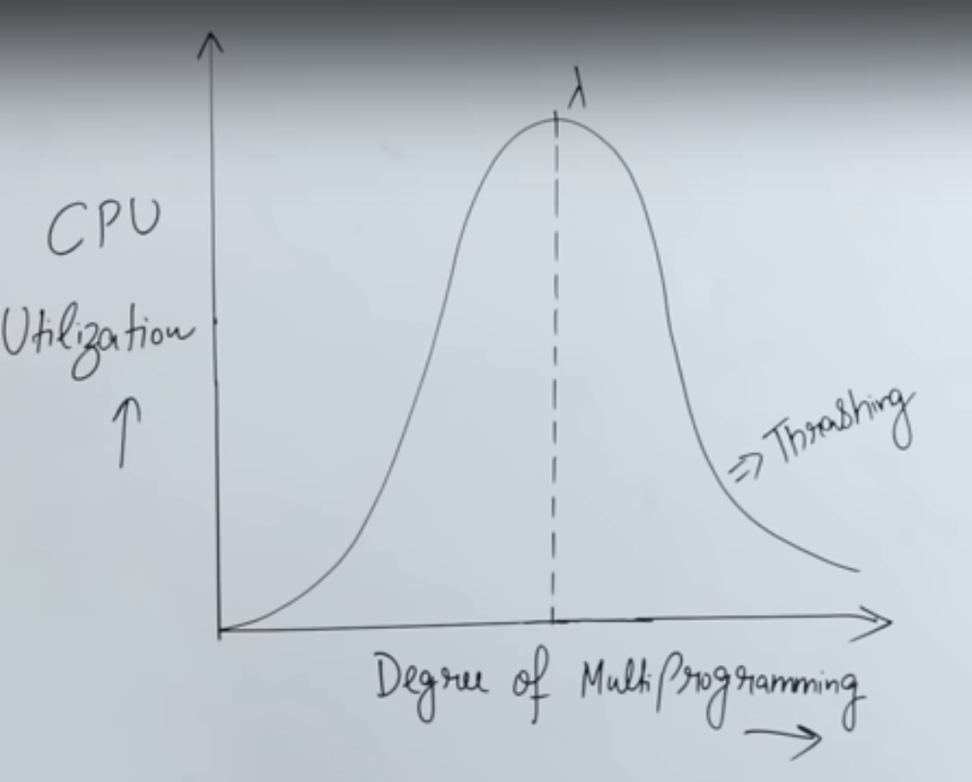

Slide 49

Thrashing
Due to this performance of the system is decreased .
After a certain limit thrashing occurs.
To avoid this problem :
Increase the main memory size
Efficiently use long term scheduler.
P1 – page1
P2– page1
P3 – page1
P4 – page1
…
P100 – page1

Slide 50
Virtual Memory
Virtual memory can be implemented in following three ways:
Demand paging
Demand Segmentation
Segmentation with Paging

Slide 51
Demand Paging
Demand paging is similar to a paging system with swapping where processes may reside in secondary memory. When we want to execute a process, we swap it into the main memory.
Rather than swapping entire process into memory we use lazy swapper.
A lazy swapper never swaps page into memory, unless that page will be needed.
If some process is needs to be swap in, then pager(page table handler) brings only those pages which will be used by process.
Thus avoid reading unused pages and decrease swap time and amount of physical memory needed.

Slide 52
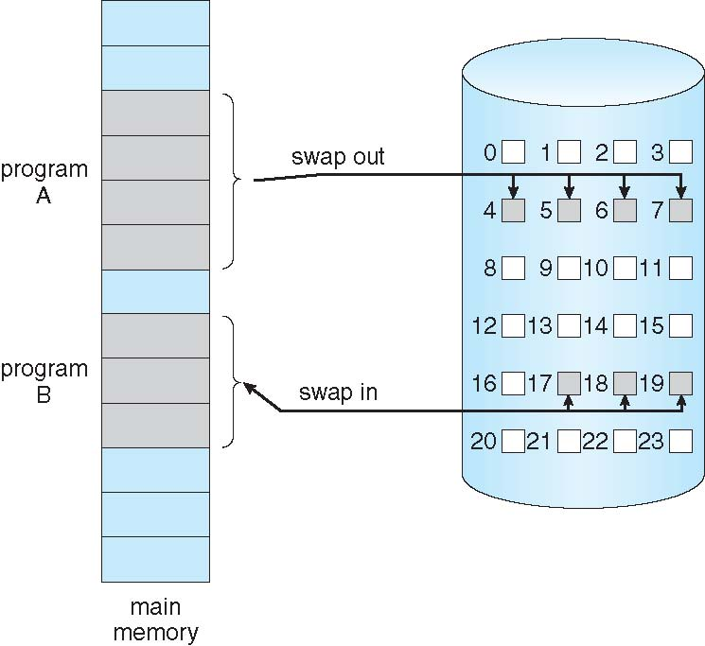
Demand Paging

Slide 53
Demand Paging- Page Fault
If a process tries to access a page that is not in main memory then it causes page fault.
Pager will generate trap to the OS, and tries to swap in.
Page table includes the valid-invalid bit for each page entry.
If the bit is valid then page is currently available in to the memory.
If it is set to invalid then page is either invalid or not present in main memory.

Slide 54
Demand Paging – Page Fault
Following steps are followed to manage page fault:
Check page table for the process to determine whether the reference is valid or invalid.
If the page is invalid then terminate the process, but if the page is valid but currently not available in main memory, then generate trap instruction.
OS determines the location of that page on swap area.
Then it will use free frame list to find out free frame. OS will schedule disk operation to read desired page into newly allocated memory.
When disk read is complete modify the page table and set reference bit to valid.
Restart the instruction.

Slide 55

Demand Paging – Page Fault

Slide 56
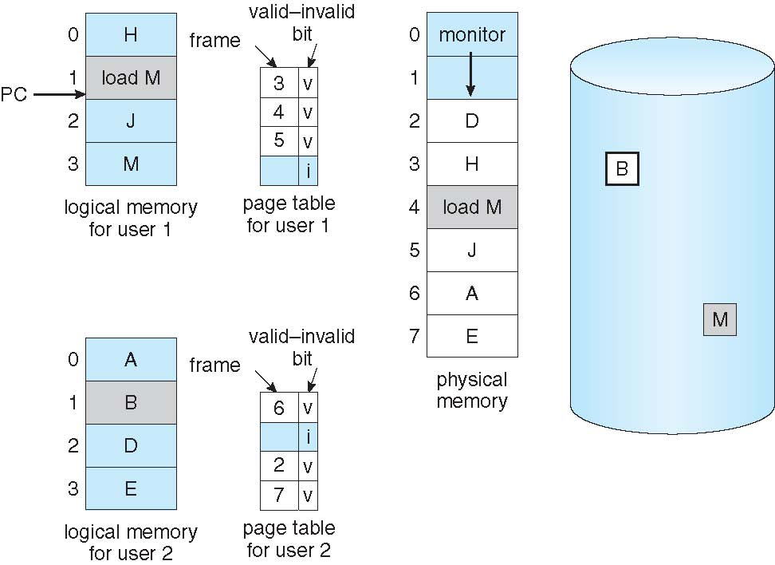
Page Replacement Policies - Need

Slide 57
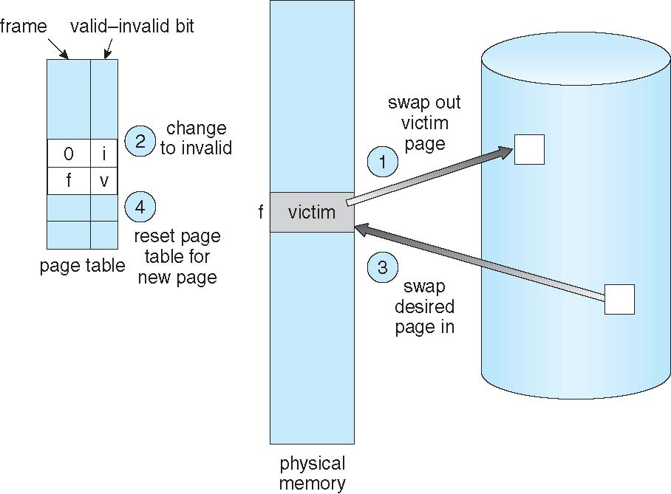
Page Replacement Policies - Basics
Find the location of the desired page on disk.
Find a free frame: - If there is a free frame, use it. - If there is no free frame, use a page replacement algorithm to select a victim frame - Write victim frame to disk if dirty
Bring the desired page into the (newly) free frame; update the page and frame tables
Continue the process by restarting the instruction that caused the trap

Slide 58
First In First Out (FIFO)
The simplest page replacement algorithm.
When the page must be replaced the oldest page is chosen.
one FIFO queue is maintained to hold all pages in memory.
Replace the page which at the top of the queue and add new pages from rear end (tail)of the queue.
Reference String : 2 3 2 1 5 2 4 5 3 2 5 2
3 frames (3 pages can be in memory at a time per process)

Slide 59
Reference String : 7,0,1,2,0,3,0,4,2,3,0,3,1,2,0
3 frames (3 pages can be in memory at a time per process) FIFO
F3 |  |  | 1 | 1 | 1 | 1 | 0 | 0 | 0 | 3 | 3 | 3 | 3 | 2 | 2
F2 |  | 0 | 0 | 0 | 0 | 3 | 3 | 3 | 2 | 2 | 2 | 2 | 1 | 1 | 1
F1 | 7 | 7 | 7 | 2 | 2 | 2 | 2 | 4 | 4 | 4 | 0 | 0 | 0 | 0 | 0
 | F | * | * | * | hit | * | * | * | * | * | * | 2hit | * | * | Hit

Slide 60
First In First Out (FIFO)
Reference String : 7,0,1,2,0,3,0,4,2,3,0,3,1,2,0
3 frames (3 pages can be in memory at a time)
Page faults/Page Miss = 12 Page hit = 3
Miss Ratio = Num of miss/ num of reference => (12/15)*100= 80%
Hit Ratio = Num of hit/ num of reference => (03/15)*100= 20%
F3 |  |  | 1 | 1 | 1 | 1 | 0 | 0 | 0 | 3 | 3 | 3 | 3 | 2 | 2
F2 |  | 0 | 0 | 0 | 0 | 3 | 3 | 3 | 2 | 2 | 2 | 2 | 1 | 1 | 1
F1 | 7 | 7 | 7 | 2 | 2 | 2 | 2 | 4 | 4 | 4 | 0 | 0 | 0 | 0 | 0
 | F | F | F | F | Hit | F | F | F | F | F | F | hit | F | F | hit

Slide 61
First In First Out (FIFO)
Reference string: 1, 2, 3, 4, 1, 2, 5, 1, 2, 3, 4, 5
3 frames (3 pages can be in memory at a time per process)
9 page faults
Find out the total page faults in the given reference string?
By using 4 frames
10 page faults and 2 page hits

Slide 62
Belady’s Anomaly in FIFO

Slide 65
f3 | 6 | 6 | 6 | 3 | 3 | 3 | 0 | 0 | 5
F2 | 5 | 5 | 1 | 1 | 1 | 6 | 6 | 6 | 3
F1 | 3 | 0 | 0 | 0 | 5 | 5 | 5 | 1 | 1

Slide 66
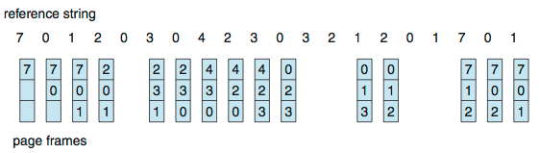
First In First Out (FIFO)
Reference string: 7,0,1,2,0,3,0,4,2,3,0,3,0,3,2,1,2,0,1,7,0,1
3 frames (3 pages can be in memory at a time per process)
15 page faults

Slide 67
First In First Out (FIFO)
Advantage
Very simple.
Easy to implement.
Disadvantage
A page fetched into memory a long time ago may have now fallen out of use.
This reasoning will often be wrong, because there will often be regions of program or data that are heavily used throughout the life of a program.
Those pages will be repeatedly paged in and out by the FIFO algorithm.

Slide 68
Least Recently Used (LRU)
It is based on the observation that if pages that have been heavily used in the last few instructions will probably be heavily used again in the next few.
Conversely, pages that have not been used for ages will probably remain unused for a long time.
This idea suggests a realizable algorithm: when a page fault occurs, throw out the page that has been unused for the longest time.

Slide 69
Least Recently Used (LRU)
Example-1 Reference string: 1, 2, 3, 4, 1, 2, 5, 1, 2, 3, 4, 5
8 page faults
(replace the least recently used pages in past)
F1 | 1 | 1 | 1 | 1 | 1 | 1 | 5
F2 | 2 | 2 | 2 | 2 | 2 | 2 | 2
F3 | 3 | 3 | 5 | 5 | 5 | 4 | 4
f4 | 4 | 4 | 4 | 4 | 3 | 3 | 3
 | 4* | 2hit | * | 2hit | * | * | *

Slide 70
Least Recently Used (LRU)
Example-2
Reference string: 7,0,1,2,0,3,0,4,2,3,0,3,0,3,2,1,2,0,1,7,0,1
3 frames (3 pages can be in memory at a time per process)
F1 | 7 | 2 | 2 | 2 | 2 | 4 | 4 | 4 | 0 | 0 | 1 | 1 | 1 | 1 | 1 | 1
F2 | 0 | 0 | 0 | 0 | 0 | 0 | 0 | 3 | 3 | 3 | 3 | 3 | 0 | 0 | 0 | 0
F3 | 1 | 1 | 1 | 3 | 3 | 3 | 2 | 2 | 2 | 2 | 2 | 2 | 2 | 2 | 7 | 7
 | 3* | * | hit | * | hit | * | * | * | * | 4hit | * | hit | * | hit | * | 2hit

Slide 71
Least Recently Used (LRU)
1. Reference string: 1,2,3,4,2,1,5,6,2,1,2,3,7,6,3,2,1,2,3,6
2. Reference string: 0172327103
4 frames (4 pages can be in memory at a time per process)
10 page faults
3 frames (3 pages can be in memory at a time per process)
15 page faults

Slide 72
Most Recently Used (MRU)
Idea of MRU- Replace the page which is most recently used in past.
Example
1. Reference string: 7,0,1,2,0,3,0,4,2,7,3
2. Reference string: 0172327103
3 frames (3 pages can be in memory at a time per process)
F1 | 7 | 7 | 7 | 7 | 7 | 7 | 7 | 3
F2 | 0 | 0 | 0 | 3 | 0 | 4 | 4 | 4
F3 | 1 | 2 | 2 | 2 | 2 | 2 | 2 | 2
 | 3* | * | hit | * | * | * | 2hit | *

Slide 73
Optimal Page Replacement
Its best page replacement policy.
The Optimal policy selects for replacement the page that will not be used for longest period of time.
Impossible to implement (need to know the future) but serves as a standard to compare with the other algorithms we shall study.

Slide 74
Optimal Page Replacement
For example: 3 frames
Reference string: 1,2,3,4,2,1,5,6,2,1,2,3,7,6,3,2,1,2,3,6
F1 | 1 | 1 | 1 | 1 | 1 | 1 | 3 | 3 | 3 | 3 | 3 | 3 | 6
f2 | 2 | 2 | 2 | 2 | 2 | 2 | 2 | 7 | 7 | 2 | 2 | 2 | 2
f3 | 3 | 4 | 4 | 5 | 6 | 6 | 6 | 6 | 6 | 6 | 1 | 1 | 1
 | 3* | * | 2hit | * | * | 3hit | * | * | 2hit | * | * | 2hit | *

Slide 75
Optimal Page Replacement
Reference string : 1, 2, 3, 4, 1, 2, 5, 1, 2, 3, 4, 5(check next pages)
4 frames
F1 | 1 | 1 | 1 | 1 | 4
F2 | 2 | 2 | 2 | 2 | 2
F3 | 3 | 3 | 3 | 3 | 3
f4 | 4 | 4 | 5 | 5 | 5
 | 4* | 2 hit | * | 3hit | *

Slide 76
Optimal Page Replacement
Need an approximation of how likely each frame is to be accessed in the future
If we base this on past behavior we got a way to track future behavior
Tracking memory accesses requires hardware support to be efficient

Slide 77
Optimal Page Replacement
Advantage:
Lowest page faults.
Can Improves performance of system as it reduces number of page faults so requires less swapping.
Disadvantage:
Very difficult to implement.

Slide 78


